Slide 1
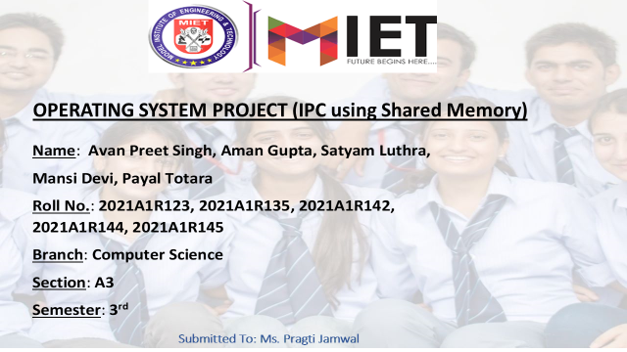


Slide 2
Inter-process communication(IPC) using Shared Memory

Slide 3
Outline
Inter-Process communication (IPC)
Shared Memory Segments
- Introduction
- Pros and Cons
- How to create and use
- Demonstration of an example with C code

Slide 4
Inter-Process Communication (IPC)
IPC is a set of methods for the exchange of data among multiple threads or processes.

Slide 5
Why do we need IPC?
Information sharing
Computational Speedup
- When parallelizing programs
Modularity
Convenience
Privilege separation
- Ability to provide access control

Slide 6
Methods of IPC
Shared memory
Named Pipes
Message passing (MPI)
Synchronization
Remote procedure calls (RPC)
Etc.

Slide 7
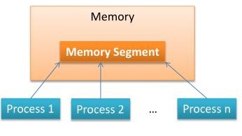
Shared Memory Segment
What is shared memory?
- Shared memory (SHM) is one method
of inter-process communication (IPC)
whereby 2 or more processes share
chunk of memory to communicate.

Slide 8
Steps of Shared Memory IPC
Creating the segment and connecting
Getting a pointer to the segment
Reading and Writing
Detaching from and deleting segments

Slide 9
1. Creating the segment and connecting
System V IPC is used in these examples
A shared memory segment is ‘created’ and ‘connected to ’ via the shmget() call
int shmget (key_t key, size_t size , int shmflg);
The key argument should be created using ftok().
The size, is the size in bytes of the shared memory segment.
The shmflg should be set to the permissions of the segment bitwise- ORd with IPC_CREAT if you want to create the segment , but can be 0 otherwise.
Upon successful completion, shmget() returns as identifier for the shared memory segment.

Slide 10
Creating the segment and connecting
Cont.
Here’s an example call that creates a 1k segment with 644 permissions (rw-r-r--)
key _t key;
int shmid;
key = ftok (“/home/beej/somefile3”, ‘R’);
shmid = shmget (key, 1024, 0644 | IPC _CREAT);

Slide 11
2. Getting a pointer to the segment
The shared memory segment must be attached using shmat() before its used.
void * shmat (int shmid, void * shmaddr, int shmflg);
shmid is the shared memory ID from the shmget() call.
shmaddr , which you can use to tell shmat() which specific address to use. When set it to 0, the OS will decide the address.
shmflg can be set to SHM_RDONLY if you only want to read from it , 0 otherwise.

Slide 12
2. Getting a pointer to the segment
Cont.
Here’s a more complete example of how to get a pointer to a shared memory segment :
key _t key;
Int shmid ;
Char *data;
key = ftok (“/home/beej/somefile3”, ‘R’);
shmid = shmget (key, 1024, 0644 | IPC_ CREAT);
data = shmat ( shmid , (void *)0, 0);

Slide 13
3. Reading and Writing
The data pointer from the above example is a char pointer. Thus it reads chars from it.
lets say the 1k shared memory segment contains a null-terminated string.
It can be printed like this:
printf(“shared contents : %s\n”, data);
And we could store something in it as easily as this:
printf(“Enter a string : “);
gets(data);

Slide 14
4. Detaching from and deleting
segments
When you’re done with the shared memory segment, your program should detach itself from it using the shmdt() call:
int shmdt (void * shmaddr);
- The only argument , shmaddr, is the address you got from shmat().
- The function returns – on error, 0 on success.

Slide 15
4. Detaching from and deleting
segments Cont.
Remember! When you detach from the segment , it isn’t destroyed. Nor is it removed when everyone detaches from it.
You have to specifically destroy it using a call to shmctl()
shmctl (shmid, IPC _RMID, NULL) ;
The above call deletes the shared memory segment, assuming no one else is attached to it.

Slide 16
Code Example
Or else,
As always, you can destroy the shared memory segment from the command line using the ipcrm Unix command.
ipcrm [ -m shmid]
Also, be sure that you don’t leave any unused shared memory segments sitting around wasting system resources.
All the System V IPC objects you own can be viewed using the ipcs command.

Slide 17
Shared Memory , Pros and Cons
Pros
- Fast bidirectional communication among
any number of processes
- Saves Resources
Cons
- Needs concurrency control (leads to data)
inconsistencies like ‘Lost update’)
- Lack of data protection from Operating System (OS)

Slide 18



